Slide 1

LESSON 1
ANTENNAS & RADIO FREQUENCY
AN INTRODUCTION TO THE ELECTROMAGNETIC SPECTRUM

Slide 2
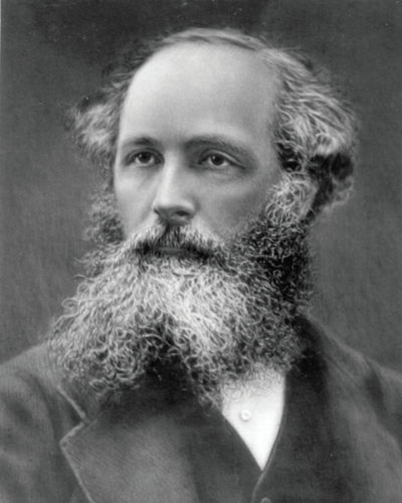
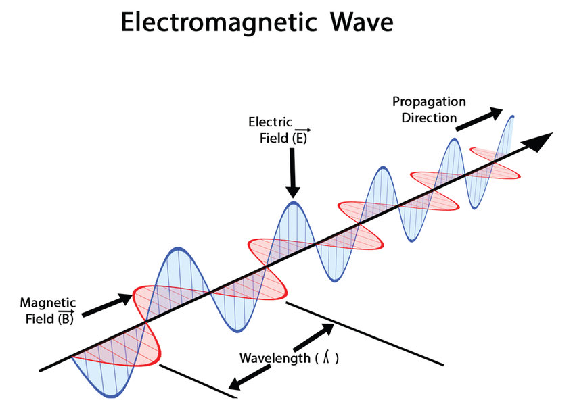
DISCOVERING THE EMS
JAMES CLERK MAXWELL
ELECTROMAGNETIC WAVE
A Scottish scientist in the field of mathematical physics. In 1865, Maxwell demonstrated that electric and magnetic fields travel through space as waves moving at the speed of light. His most notable achievement was to formulate the classical theory of electromagnetic radiation, bringing together for the first time electricity, magnetism, and light as manifestations of the same phenomenon. Maxwell’s equations for electromagnetism have been called the “second great unification in physics” after the first one realized by Isaac Newton.
According to Maxwell’s equation, a spatially varying electrical field generates a time varying magnetic field, and these oscillating fields form an electromagnetic wave.

Slide 3
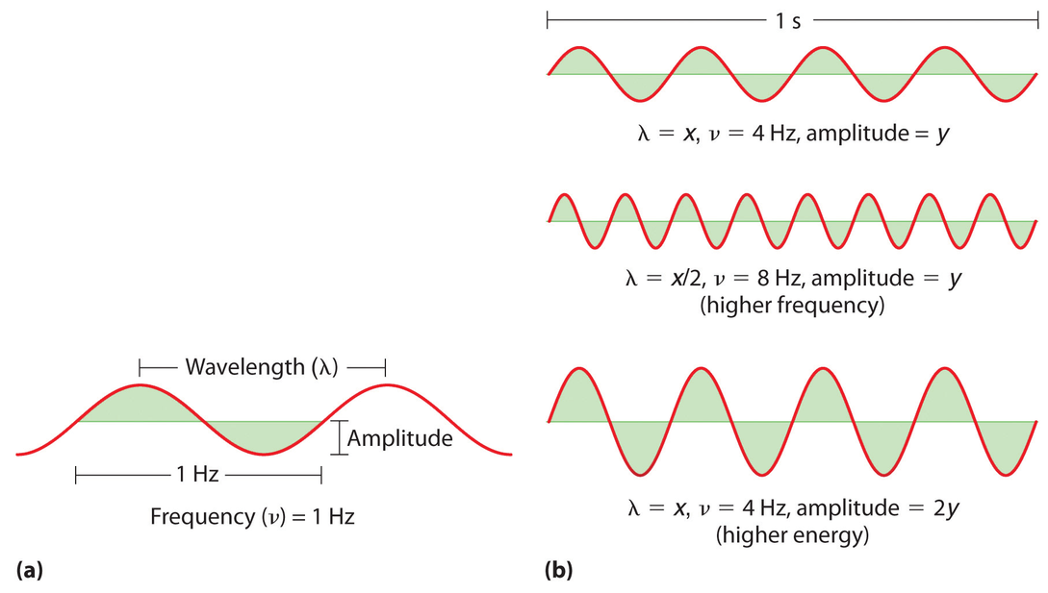
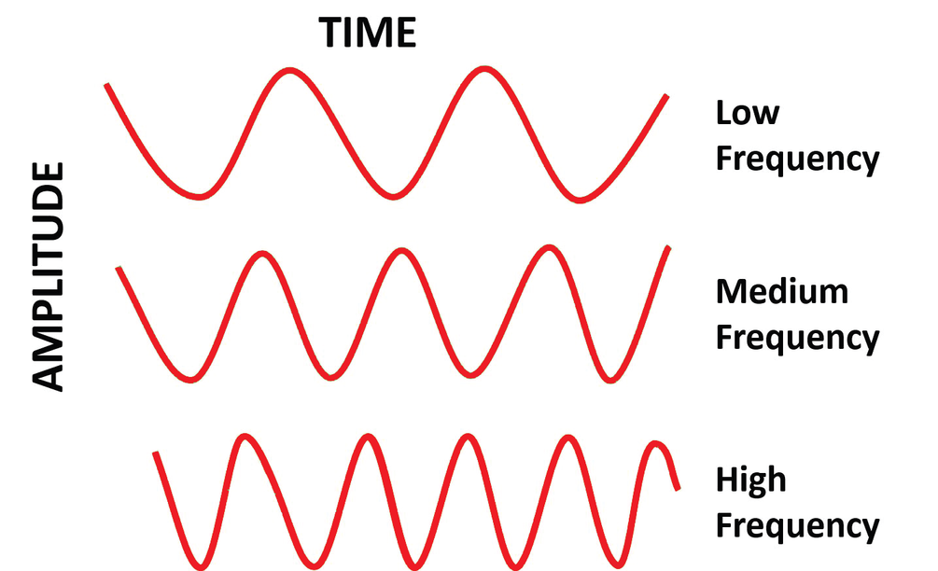
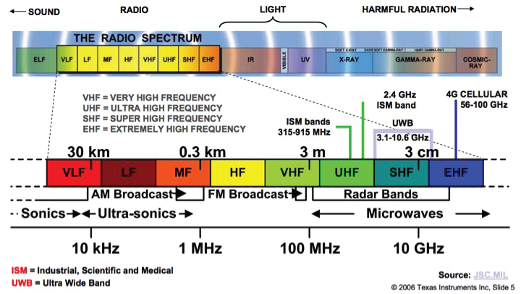
RADIO WAVES
RADIO THEORY
Radio waves are generated by a rapidly oscillating electric current.
Frequency: The number of cycles a radio wave makes referenced to one second of time.
Wavelength: The distance the wave travels to complete one cycle.
EM WAVE MEASUREMENT
A wave, or sinusoid, can be completely described by either its frequency (f) or wavelength (λ).
They are inversely proportional to each other and related to the speed of light through a particular medium. The relationship in a vacuum is shown in the following equation where C is the speed of light: C = f λ
As frequency (f) increases, wavelength (λ) decreases.
For reference, a 1 GHz wave has a wavelength of roughly 1 foot, and a 100 MHz wave has a wavelength of roughly 10 feet.
RADIO AND LIGHT WAVES
Both radio waves and light waves are electromagnetic energy.
They have similar properties. For example, radio waves travel in much the same way as light. The energy is similarly sent in all directions.
They also both can be reflected, absorbed, diffracted, and dispersed.

Slide 4
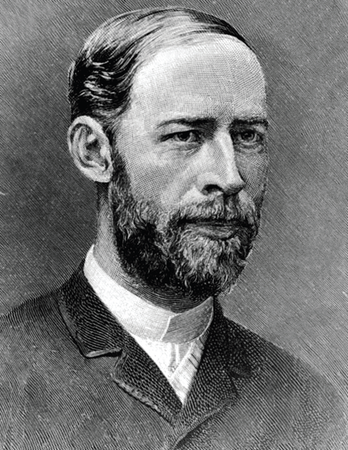
THE FIRST ANTENNAS
ANTENNA CONCEPTS
Directionality: Directivity is fundamental to antennas. It’s a measure of how “directional” an antenna’s radiation pattern is – omnidirectional (360-degree coverage) or directional (limited coverage).
Radiation pattern: The relative distribution of radiated power as a functional of direction in space.
Gain: An antenna’s efficiency is a measure of how much power is radiated by the antenna relative to the antenna input power. Measured in dBi and dB.
Beamwidth: An antenna’s radio pattern in the far field is often characterized by beamwidth and sidelobe levels. Measured in degrees.
Polarization: All electromagnetic plane waves have an associated polarization. The antenna concepts of linear, circular, and elliptical polarization are presented.
Bandwidth: The frequency range over which the antenna radiates. Defined in different ways.
WHAT IS AN ANTENNA?
An antenna is an electrical device that converts electric currents into radio waves and vice versa.
It is usually used with a radio transmitter or radio receiver. In transmission, a radio transmitter applies an oscillating radio frequency electric current to the antenna’s terminals, and the antenna radiates the energy from the current as electromagnetic waves.
HEINRICH HERTZ
The first antennas were built in 1888 by German physicist Heinrich Hertz in his pioneering experiments to prove the existence of electromagnetic waves predicted by the theory of James Clerk Maxwell.

Slide 5
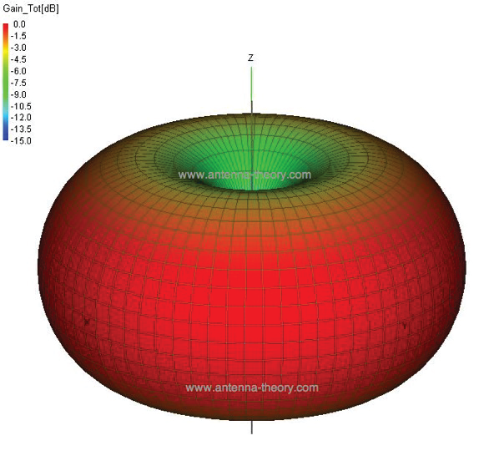
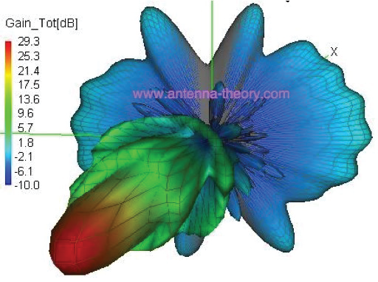
ANTENNA THEORY
A theoretical isotropic antenna has a perfect 360 degree vertical and horizontal beamwidth. This is a reference for all antennas.
High-gain omnidirectional antennas:
Include more coverage area in a circular pattern.
Have a lower energy level directly above or below the antenna.
This is an example of a donut-shaped or toroidal radiation pattern. In this case, along the z-axis, which would correspond to the radiation directly overhead the antenna, there is little power transmitted. In the x-y plane (perpendicular to the z-axis), the radiation is maximum. These plots are useful for visualizing which directions the antenna radiates.
This is an example of a directional antenna pattern, which does not have symmetry in the radiation pattern. These antennas typically have a single peak direction in the radiation pattern – this is the direction in which the bulk of the radiated power travels. These antennas are common. Examples of antennas with highly directional radiation patterns include the dish antenna and the slotted waveguide antenna.

Slide 6
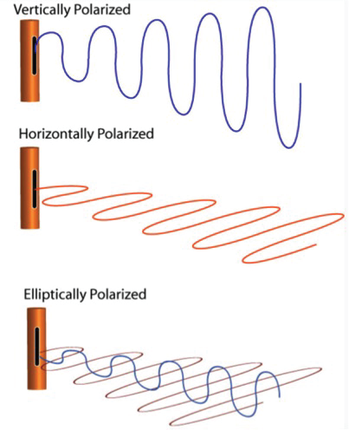
ANTENNA POLARIZATION
This concept is important for antenna-to-antenna communication. The polarization of an antenna is the polarization of the radiated fields produced by an antenna, evaluated in the far field. That is why antennas are often classified as “linearly polarized” or a “right hand circularly polarized antenna.”
Antennas transmit and receive in the same manner.
It’s better to keep the orientations of the two antennas matched. A horizontally polarized antenna will not communicate with a vertically polarized antenna. Reception is bets when the receiving antenna is not in a position that prevents the polarization from being too far off the transmitting antenna.
In general, for two linearly polarized antennas that are rotated from each other by angle ϕ, the power loss due to this polarization mismatch will be described by the Polarization Loss Factor (PLF), where PLF = cos2ϕ.

Slide 7
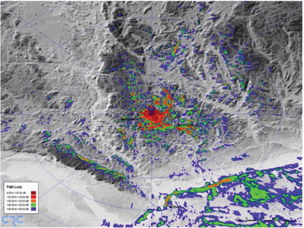
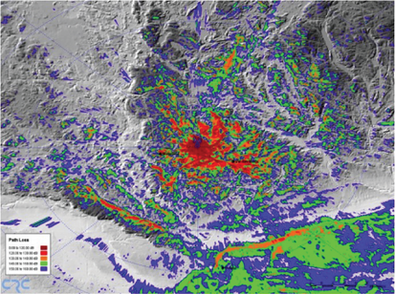
RADIO FREQUENCY PROPOGATION
RF WAVE TRANSMISSION
Lower frequencies (between 30 and 3,000 kHz) have the property of following the curvature of the Earth via surface wave propagation in most occurrences.
Line-of-sight (LOS), space wave, is the direct propagation of radio waves between antennas that are visible to each other.
This is the most common of the radio propagation modes at VHF and higher frequencies.
Skywave propagation is any of the modes that rely on refraction of radio waves in the ionosphere, which is made up of one or more ionized layers in the upper atmosphere.
WHAT DISRUPTS LOS?
The following obstructions might obscure a visual link:
Topographic features, such as mountains
The curvature of the Earth
Buildings or other man-made objects
Trees
Line-of-sight disappears at 6 miles (9.7 km) due to the Earth’s curve.
FREQUENCY’S IMPACT
Radio waves at different frequencies propagate in different ways.
2,500 MHz
700 MHz

