Slide 1

LESSON 3
RADAR
AN INTRODUCTION TO THE ELECTROMAGNETIC SPECTRUM

Slide 2
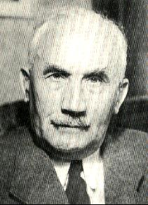
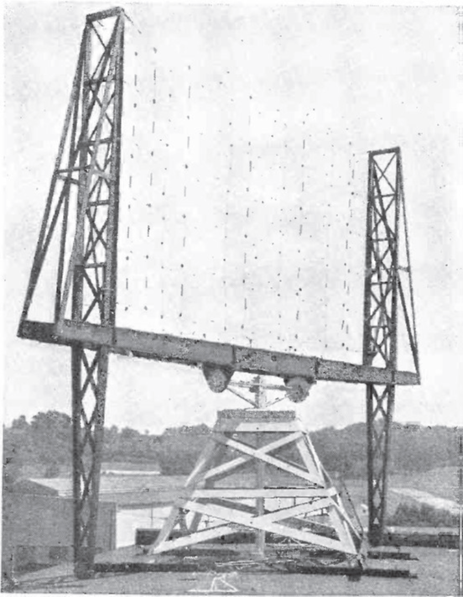
EARLY RADAR
A TIMELINE
1904: Following the discoveries of James Clerk Maxwell and Heinrich Hertz, German engineer Christian Hülsmeyer invented the telemobiloscope, the first practical radar test. By measuring the running time of electromagnetic waves to a metal object and back, this invention could detect ships in fog to avoid collisions.
1922: American electrical engineers Albert H. Taylor and Leo C. Young located a wooden ship for the first time, demonstrating the first continuous wave (CW) interference detector.
1930: Lawrence A. Hyland located an aircraft for the first time using radar.
1931: The first ship is equipped with radar. The antennas used were parabolic dishes with horn radiators.
1936: The klystron is developed by the technicians and brothers Russell and Sigurd Varian. It will be an important component in radar units as an amplifier or oscillator tube.
1940: Different radar equipment is developed in the US, Russia, Germany, France, and Japan during WWII.

Slide 3
WHAT IS RADAR?
WHAT IT MEANS
The word radar, coined by the US Navy in 1940, is an acronym for RAdio Detection And Ranging. Radars are used to detect the presence of an object and to determine its location. The name implies that the only parameter measure is range, but modern radars measure range, direction, and often altitude.
RADAR ENVIRONMENT
Radar transmits electromagnetic waves, and it can receive echoes from targets, electromagnetic interference, electronic attack, external environmental noise, and internal system noise. Radar can measure direction (azimuth), elevation, range, Doppler shift, amplitude, and polarization.
ELEMENTS OF RADAR
The figure at the bottom shows the basic elements of a radar. The radar antenna illuminates the target with a radio frequency signal, which is then reflected and picked up by the same or collocated antenna. The radar signal is generated by a powerful transmitter and received by a highly sensitive receiver. The range is determined by the amount of time the echo is delayed. The direction and/or elevation are determined by where the antenna is pointed.

Slide 4
RADAR PRICIPLES
DETERMINING RANGE
Since the propagation of radio waves happens at constant speed, the range is determined using the time it takes for the radar signal to reach the target and return. The formula for calculating range is:
R = C x t/2
C = speed of light
T = time elapsed from pulse transmission to receive the echo
R = slant range from the radar to the target
Since the waves travel to a target and back, the round-trip time is dividing by 2 to obtain the time the wave took to reach the target.
The slant range is the line-of-sight distance between the radar and the object illuminated.
The ground range is the horizontal distance between the emitter and its target. The calculation of the ground range to an airborne target requires knowledge of the target’s elevation.
RF ENERGY
Radar uses electromagnetic energy pulses. The radio frequency (RF) energy is transmitted to and reflected from the reflecting object. A small portion of the reflected energy returns to the radar set.
This returned energy is called an echo. Radar sets use the time between transmission of the signal and reception of the echo to determine the distance of the reflecting object.
The time required for an echo to return can be converted to distance using the speed of light (300,000 km/sec).
The direction can be determined from how the antenna is aimed.
RADAR MILE
This is the time required for a radar signal to travel 1 mile from the transmitter to an object.

Slide 5
PULSED RADARS
Radar systems radiate each pulse at some set frequency, wait for returning echoes during listening or rest time, and then radiate the next pulse.
The time between the beginning of one pulse and the beginning of the next pulse is called Pulse-Repetition Time (PRT) and is equal to Pulse Repetition Frequency (PRF), which is the number of pulses transmitted per second and is the reciprocal of PRT.
MAXIMUM UNAMBIGUOUS RANGE
RESOLUTION CELLS
A radar’s pulse width, horizontal beamwidth, and vertical beamwidth form a 3D resolution cell (RC). An RC is the smallest volume of airspace in which a radar cannot determine the presence of more than one target. The RC of a radar is a measure of how well the radar can resolve targets in range, azimuth, and altitude. The closer to the radar, the smaller the RC. This shows that:
The shorter the pulse width = the better the range resolution capability of a radar system.
The narrower the horizontal beamwidth = the better the azimuth resolution capability.
The narrower the vertical beamwidth = the better the altitude resolution capability.
A radar cannot send out another pulse until a time window to allow for “seeing” echoes has passed.
The maximum measuring distance (Rmax) of a radar is determined by the duration of the receiving time allocated.
The radar timing system must be reset to zero each time a pulse is radiated to ensure that the range detected is measured from time zero each time.
The maximum range at which a target can be located to avoid ambiguity is determined by the PRT. This duration determines that maximum unambiguous range of a given radar. This is true for convention pulse radars.

Slide 6
RADAR SYSTEMS
FUNDAMENTALS
COMPONENTS AND FUNCTIONS
DIRECTION AND ELEVATION
MORE ABOUT ELEVATION
Transmitter: Converts the direct current pulses into short, high-power pulses of RF energy.
Duplexer: A switch that allows single antenna operations – used to protect the receiver from high-power transmissions entering directly from the transmitter.
Receiver: Amplifies and demodulates the received RF signals and provides videos signals on the output.
Radar antenna: Transfers the transmitter energy to signals in space with the required distribution and efficiency. Applied in an identical way on reception.
Display: Presents to the observer a continuous graphic picture of the relative position of radar targets.
Radar screen: Displays the data produced from the echo signals as bright blips.
The angular determination of the target is determined by the antenna’s direction. The accuracy of the measurement is determined by directivity, which is the ability of the antenna to concentrate the transmitted energy in a particular direction (azimuth and/or elevation). By measuring the direction the antenna is pointing when the echo is received, the azimuth/elevation from the radar to the object is determined.
The size and characteristics of a target’s reflected radar energy is RSC and represented by the symbol sigma σ. RCS is measured in square meters (m²). If all of the radar energy on the target were reflected equally in all directions, the RCS would be equal to the target’s cross-sectional area as seen by the transmitter. In practice, some energy is absorbed and the reflected energy is not distributed equally in all directions. The target radar cross sectional area depends on the:
Airplane’s physical geometry and exterior features
Direction of the illuminating radar
Radar transmitter’s frequency
Material of the reflecting surface

Slide 7
DOPPLER
SHIFT
The Doppler effect takes advantage of the fact that the frequency of RF waves will be changed or shifted when reflected from a target moving relative to the radar.
The shifted frequency of the returning RF wave depends on the movement of the aircraft in relation to the radar. For a stationary target, the frequency of the reflected signal will equal the frequency of the transmitted signal. For a target moving toward the radar, the frequency of the reflected signal will be higher than the transmitted signal. The reflected frequency for a target moving away from the radar will be lower than the transmitted frequency.
Using a Doppler radar reduces the clutter of detecting non-moving objects, like terrain, buildings, and ocean waves.

Slide 8
RADIATION PATTERNS
Energy radiated from an antenna forms a field having a definite radiation pattern. A radiation pattern is a way of plotting the radiated energy from an antenna. This energy is measured at various angles at a constant distance from the antenna. The shape of this pattern depends on the type of antenna used.
The main beam (or main lobe) is the region around the direction of maximum radiation. The main beam in the top image is shown radiating north.
The side lobes and back lobe are smaller beams of energy that radiate away from the main beam.
Side lobes are radiation in undesired directions and can never be eliminated.
The back lobe is the portion of radiation pattern that is directed opposing the main beam direction.
The side lobe and back lobe levels are important parameters used to characterize radiation patterns. It is the maximum value of the energy radiated from other than the main beam and is expressed in decibels.

Slide 9
OTHER RADAR SYSTEMS
CW RADARS
DIFFERENT RADAR SCANS
Continuous wave radar sets transmit a high-frequency signal continuously. The echo signal is received and processed permanently. The radar must solve two problems when using CW:
Preventing the direct connection of the transmitted energy into the receiver.
Assigning the received echoes to a time system to be able to do range measurements.
A direct connection of the transmitted energy into the receiver can be prevented by spatial separation of the transmitting antenna and the receiving antenna. The target is illuminated by a transmitter with the receiver using a different antenna nearby or possibly in a missile.
ELECTRONICALLY SCANNED ARRAY
Air search radar systems initially detect and determine the position, course, and speed of air targets in a relatively large area. The maximum range of air search radar can exceed 300 miles, and the bearing coverage is a complete 360 degrees.
Air search systems are usually divided into two categories based on the amount of position information supplied:
Radar sets that provide only range and bearing information are referred to as 2D radars.
Radar sets that supply range, bearing, and height are called 3D radars.
MONO PULSE RADARS

