Slide 1

LESSON 4
ELECTROMAGNETIC WARFARE
AN INTRODUCTION TO THE ELECTROMAGNETIC SPECTRUM

Slide 2
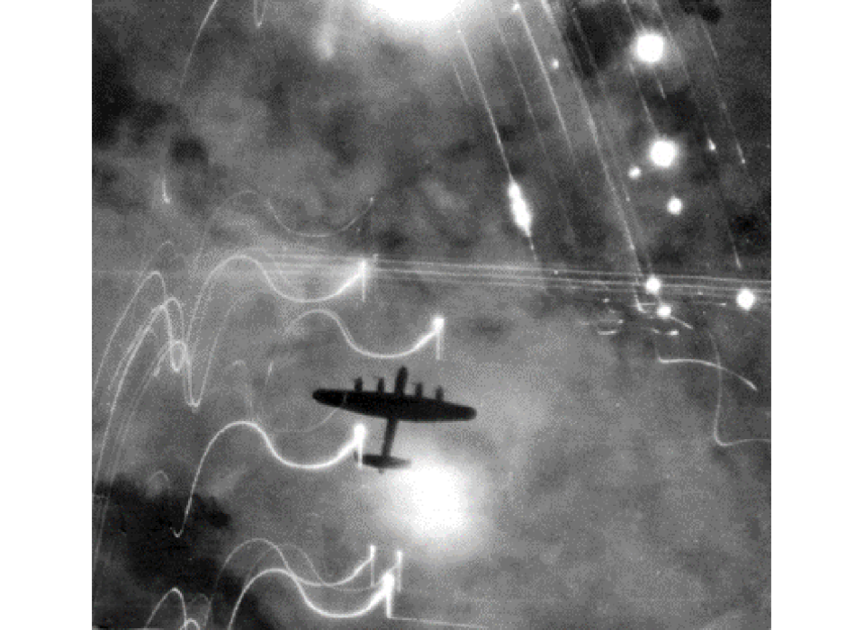
THE HISTORY OF EW
During the American Civil War (1861-1865), the Union and Confederacy began using the telegraph to communicate military operations. Both sides quickly learned how to sabotage their enemy by cutting telegraph wires, switching traffic, and transmitting false signals on enemy lines.
During the Russo-Japanese War (1904-1905), both Russian and Japanese forces used radio jamming during the Siege of Port Arthur.
In World War II (1939-1945), in the Battle of the Beams, the German Luftwaffe introduced accurate radio navigation systems that enabled night bombings in Britain. British scientific intelligence fought back with a variety of their own effective countermeasures to jam and distort German signals. Later, during what was called Operation Gomorrah, Allied forces used “window,” also known as chaff, to render German radar all but useless.
In the 1982 Lebanon War, the Israeli Air Force destroyed the Syrian surface-to-air missile network over two days without losing a single aircraft. The lesson out of this conflict was that to win a land battle, you must first control the air, and to control the air, you must dominate the electromagnetic spectrum. Bekaa Valley demonstrated that EMS warfighting capability is a necessity in modern warfare.
When a US-led coalition launched Desert Storm in January 1991, US Air Force crews hit the radiate switch on their ALQ-99 systems, unleashing noise and deception jamming signals into Iraq’s airwaves. Supported by the EC-130 Compass Call jamming of communications frequencies, the efforts his multiple waves of inbound strike aircraft and cruise missiles from radars and paralyzed Iraq’s communications network.
Today, the EMS has been pivotal to modern conflicts, including in the Russo-Ukrainian War, where Ukraine has adapted technology, particularly drones, to gain a critical advantage in the electromagnetic spectrum.

Slide 3
WHAT IS EW?
ELECTRONIC ATTACK (EA)
ELECTRONIC WARFARE SUPPORT (ES)
ELECTRONIC PROTECTION (EP)
EA involves the use of electromagnetic or radio frequency energy, directed energy, or anti-radiation weapons to attack personnel, facilities, or equipment with the intent of degrading, neutralizing, or destroying enemy combat capability and is considered a form of fires.
ES involves actions tasked by, or under the direct control of, an operational commander to search for, intercept, identify, and locate or localize sources of intentional and unintentional radiated electromagnetic energy for the purpose of immediate threat recognition, targeting, planning, and conduct of future operations.
EP involves actions taken to protect personnel, facilities, and equipment from any effects of friendly or enemy use of the electromagnetic spectrum that degrade, neutralize, or destroy friendly combat capability. EP includes actions taken to ensure friendly use of the electromagnetic spectrum, such as frequency agility in a radio or variable pulse repetition frequency in radar.

Slide 4
ALL ABOUT JAMMING
RADAR VS. COMMUNICATIONS
Jamming is to interfere with or prevent the clear reception of broadcast signals by electronic means. Radio jamming is the transmission of radio signals that disrupt communications by decreasing the signal-to-noise ratio. A jammer tuned to the same frequency as the transmitter – with enough power – can override the signal transmitted to the receiver.
JAMMING FACTORS
Radar jamming causes radar to fail to acquire the target, to stop tracking the target, or to present false information. Radar jamming effectiveness is largely determined by the J/S ratio. The radar’s returning target echo must travel two directions – from the radar to the target and back.
Communications jamming interferes with the ability to pass information over a communications link. Its effectiveness is also largely determined by the J/S ratio. The communications signal must travel in only one direction – from the transmitter to the receiver – making communications signals more difficult to jam than radar signals.
The basic factors that affect whether jamming is successful or not include transmitter power, jammer power, distance of the transmitter to the receiver, distance of the jammer to the receiver, and conductivity of the environment.
In most situations, for a jamming signal to be effective, the jammer-to-signal (J/S) ratio must be greater than 1. The ratio is the power level of the jammer divided by the power level of the returning target echo.
If the distance between the jammer and receiver is doubled, the jammer must quadruple its output for the jamming to have the same effect.

Slide 5
JAMMING STRATEGIES
TYPES OF JAMMING
Pre-emptive jamming is always on. The jamming power at the victim receiver is reduced as more frequencies (larger bandwidth) are covered. It does not require a receiver in the jamming system.
Spot jamming focuses energy and provides limited frequency coverage.
Barrage jamming spreads the coverage and covers a greater bandwidth.
Swept jamming focuses energy, can cover a significantly great bandwidth. Its effectiveness is impacted by the duty cycle of the receiver.
Digital technique jamming requires less power as you are not “blocking” the signal.
DIGITAL RADIO FREQUENCY MEMORY (DRFM)
DRFM digitizes the received signal and stores a coherent (exact) copy in digital memory. When needed, the signal can be replicated and retransmitted. DRFM artificially shifts the signal properties in time and sends them back to the radar. This causes the radar to make incorrect deductions about the velocity and range of the target.
CHAFF AND FLARES
These are among the most widely used and effective expendable electronic attack devices. They are dispensed in the air to decoy radar-guided surface-to-air missiles (chaff) and infrared-guided SAMs (flares).

